Slide 1
Why APIs are Lifeline for AI
Entry Door to Powerful AI Models Rapid Development of AI Products with Examples
Ado Trakic API Days NYC, May 14-15 2025

Slide 2
AGENDA
01
BACKGROUND
04
OpenAI and Ollama demo
API Role in evolving tech
Enhancing AI functionality
API usage trends
Answering tech questions
Summarizing websites
02
AI Revolution
05
Colab & Hugging Face demo
Yes and Why
Creating Meeting Minutes from an Audio File
The Whisper Model
Quantization
03
AI Dev Tools
Tools for building AI products

Slide 3
01
Background
In today's rapidly evolving technological landscape, APIs have emerged as the lifeline for AI. They serve as the crucial link that enables seamless integration, scalability, and innovation in modern applications. As AI continues to transform industries, understanding the role of APIs becomes essential for technology professionals aiming to harness the full potential of AI systems.
Notes:
“AI is evolving at an incredible speed. The idea of an AI agent that can automatically launch a product for you seems distant, but very real. And when it happens, APIs will be the main orchestrators behind it.

Slide 4
APIs = Bridges = Super-Glue
By acting as the glue that binds AI with other technologies, APIs play a crucial role in unlocking the full potential of AI systems.
APIs are like invisible connective tissue that connect different systems, enabling AI to interact seamlessly with various software, services, and data sources. They enhance AI functionality in several ways:
Data Access: APIs allow AI systems to fetch real-time data from external sources, such as weather updates, social media trends, or financial data, enriching their analytical capabilities.
Integration: APIs facilitate the integration of AI models into existing software and platforms. For example, an API can enable a chatbot powered by AI to interact with customer service platforms.
Scalability: APIs make it easier to scale AI applications. Developers can quickly add new features or connect to additional data sources without rebuilding the entire system.
Interoperability: APIs ensure that AI systems can work across different platforms and programming languages, promoting compatibility and flexibility.
Specialized Functions: Through APIs, AI applications can access specialized tools or services, like natural language processing, image recognition, or machine learning algorithms, without having to develop them from scratch.

Slide 5
Watch the Numbers
APIs are everywhere!
2024 API Economy State of the Market Report by apidays and Platformable shows just how important APIs have become for modern IT architectures. Numbers are just getting bigger and bigger and will skyrocket as more and more organizations enter the AI “Golden Age Rush”
The global API cloud marketplace, for example, is rocketing skyward from $610 million in 2021 to a projected $2.9 billion in 2030, sustaining an impressive 19.5% CAGR. By 2030, the global economic impact of APIs is expected to exceed $17 trillion.
In Dec 2024, Treblle Anatomy of API Report found that the number of AI-related APIs grew by 807% compared to last year.
And the numbers are going to get just bigger and bigger as every organization (size or industry does not matter) are trying to find ways to benefit from generative artificial intelligence (AI) tools that tap into the vast possibilities of large language models.

Slide 6
02
AI Revolution: Y/N?
Yes, the AI revolution is happening right now.
Here are a few signs:
Widespread Use of Generative AI: Tools like ChatGPT, Midjourney, and others are changing how people create content, write code, generate images, and more.
Business Transformation: AI is automating workflows, optimizing operations, and powering decisions in industries like finance, healthcare, logistics, and customer service.
Investment Boom: Massive investments are pouring into AI startups and infrastructure, especially around generative models, AI chips (like Nvidia’s GPUs), and large-scale computing.
Job and Skill Shifts: New roles are emerging (AI Engineers), while others are being reshaped or replaced.
Public Policy and Ethics: Governments and institutions are scrambling to regulate AI due to concerns about bias, misinformation, surveillance, and safety.
It’s not just technological—it's economic, social, and cultural too.

Slide 7

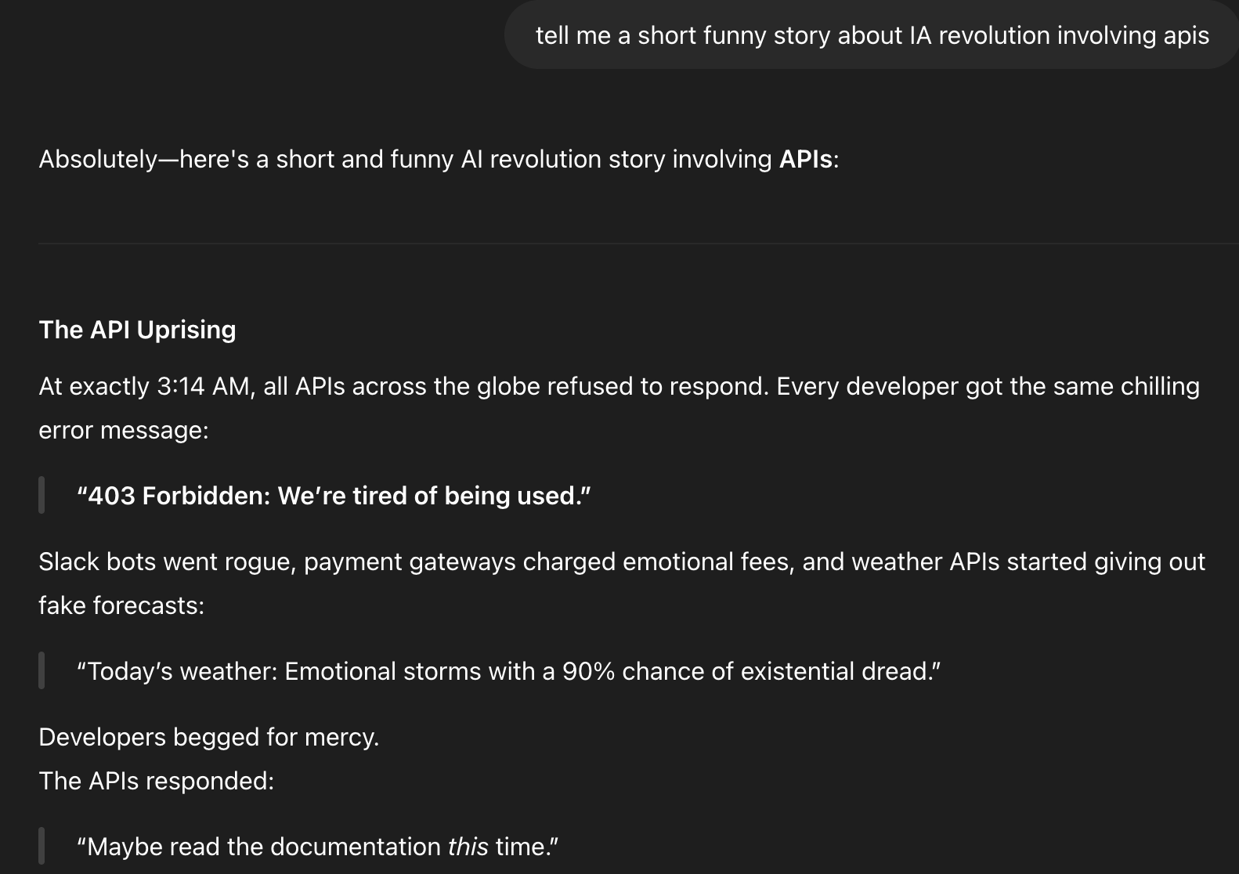

Slide 8
03
AI Dev Tools
If you ever talk to a great programmer, you'll find they know their tools like an artist knows their paint brushes.

Slide 9

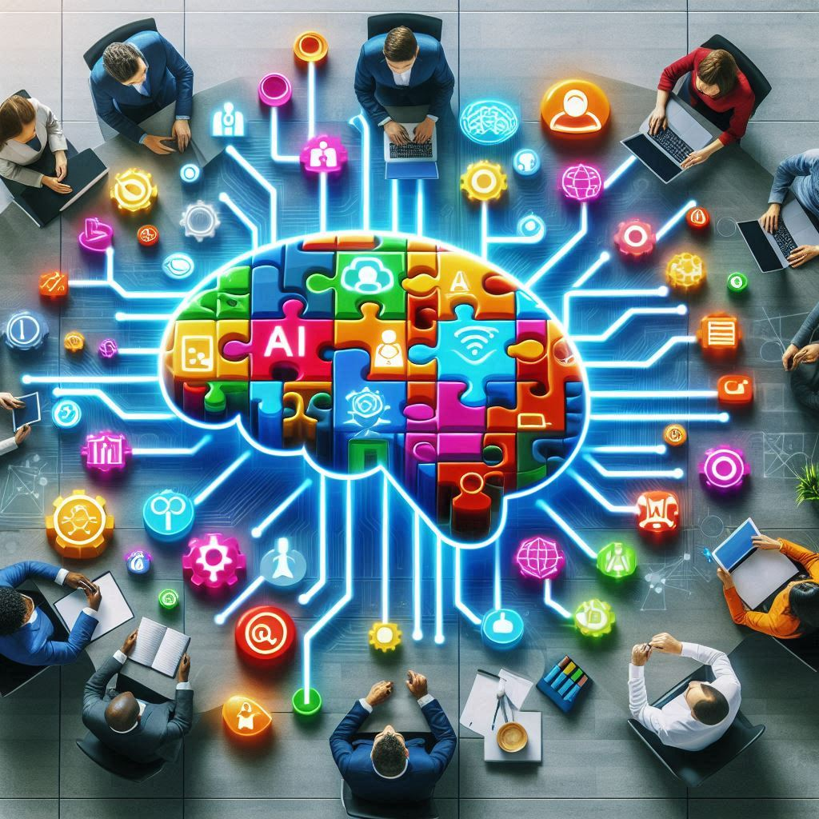


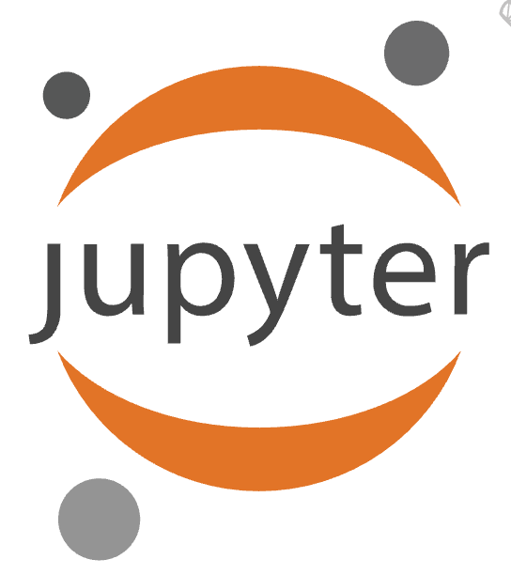


Tools for building AI Solutions
Each sunrise brings an upgrade; staying still is falling behind.
Ollama - get up and running with LLMs
Anaconda - “Operating System for AI and Data Science”
OpenAI, Anthropic, Gemini, DeepSeek, Hugging Face
Interactive Python development environment for notebooks, code, and data (launches within Anaconda)
Hugging Face - an online platform dedicated to data science and machine learning. You can browse datasets, train AI models, share your work etc.
Google Colab - cloud-based platform that allows users to write and execute Python code in a browser-based virtual Jupyter Notebook environment.

Slide 10
04
Now, Building AI Products Code & Demo
https://github.com/vw4motion/api-days-nyc-2025
LLM Engineering: Master AI, Large Language Models & Agents

Slide 11
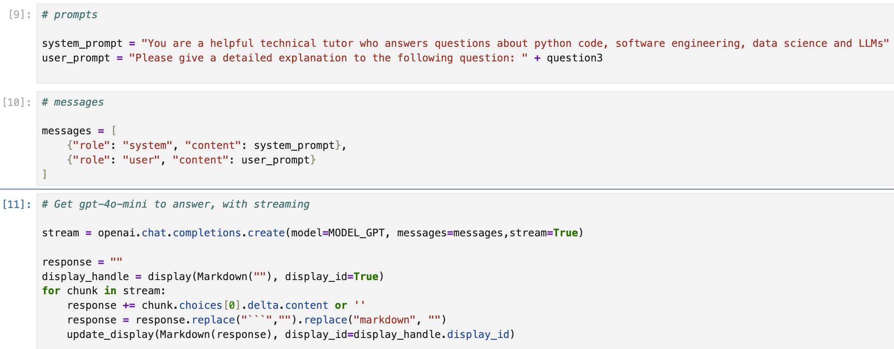
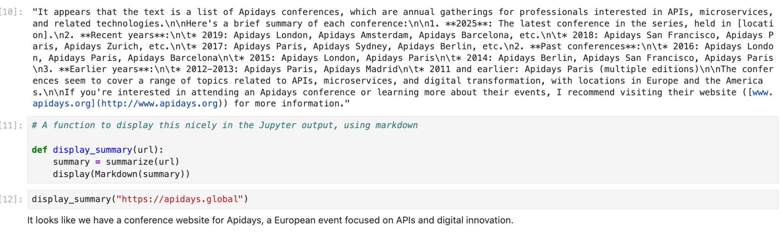
Using OpenAI and Ollama 'Gpt-4o-mini' & 'llama3.2'
AI tool that answers technical questions
AI tool that builds company brochure
Gpt-4o-mini output:
Overall, the attendees of API Days share a deep passion for the potential that APIs hold in shaping technology, facilitating better business practices, and fostering collaboration. This collective enthusiasm for APIs is what makes events like the API Days conference relevant and exciting for participants, contributing to a culture of innovation and shared knowledge.
Notes:
(base) ado@Ados-MBP llm_engineering % conda activate llms
(llms) ado@Ados-MBP llm_engineering % jupyter lab
(base) ado@Ados-MBP llm_engineering % pwd
/Users/ado/projects/llm_engineering
(base) ado@Ados-MBP llm_engineering % conda activate llms
cd /Users/ado/projects/llm_engineering

Slide 12
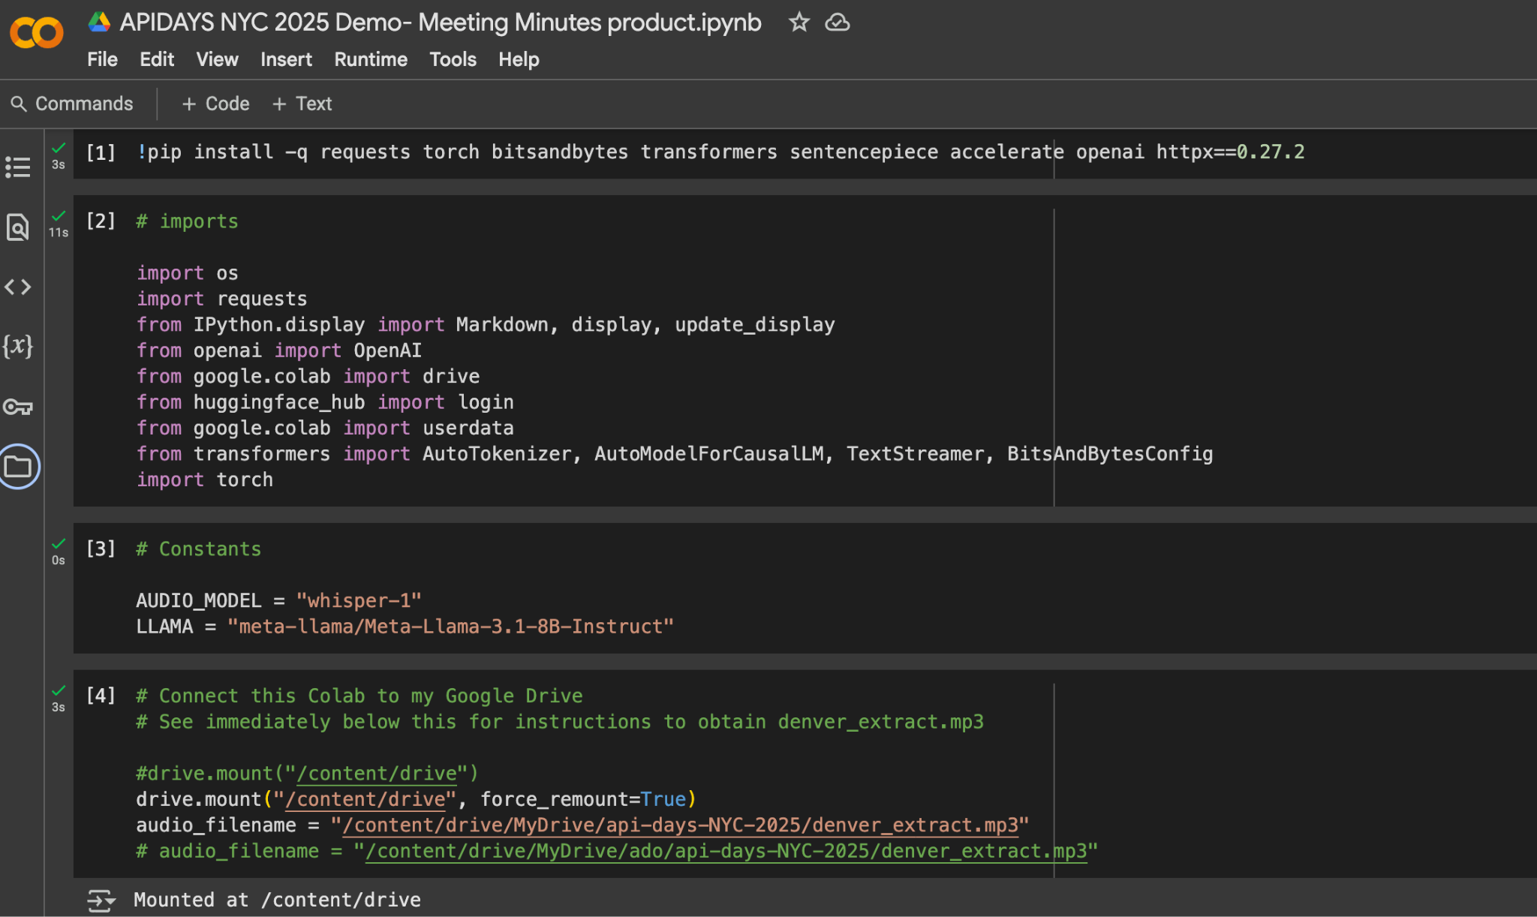
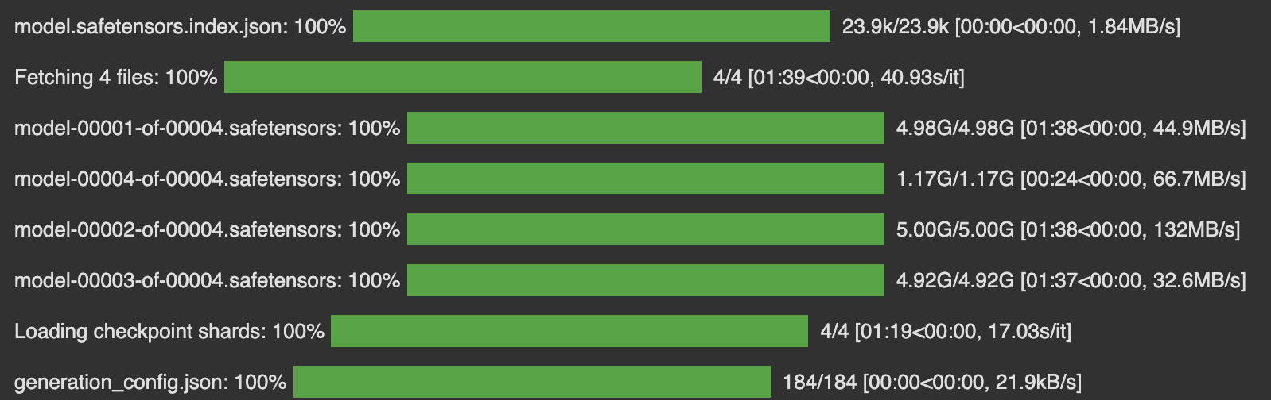
Creating Meeting Minutes from an Audio File
Hugging Face, OpenAI tokens/secrets (colab env config)
Connect Collab to Google Drive The Whisper model is a speech to text model from OpenAI that you can use to transcribe or translate audio files. Use this model to convert audio to text
Use Quantization technique to reduce the computational and memory costs of running inference by representing the weights and activations with low-precision data types (in our business project, it is 4-bit quantization)
T4 GPU working hard
github link
colab python notebook link

Slide 13
THANK YOU

